Slide 1

LINEAR PROGRAMMING
Prof. Zhenyu He
Harbin Institute of Technology (Shenzhen)

Slide 2
A Political Problem
Policy | urban | suburban | rural
Build roads | -2 | 5 | 3
Gun control | 8 | 2 | -5
Farm subsidies | 0 | 0 | 10
Gasoline tax | 10 | 0 | -2
The effect of policies on voters.

Slide 3
We format this problem as
Minimize:
Subject to:

Slide 4
General linear programs
Linear equality
Linear inequality
or

Slide 5

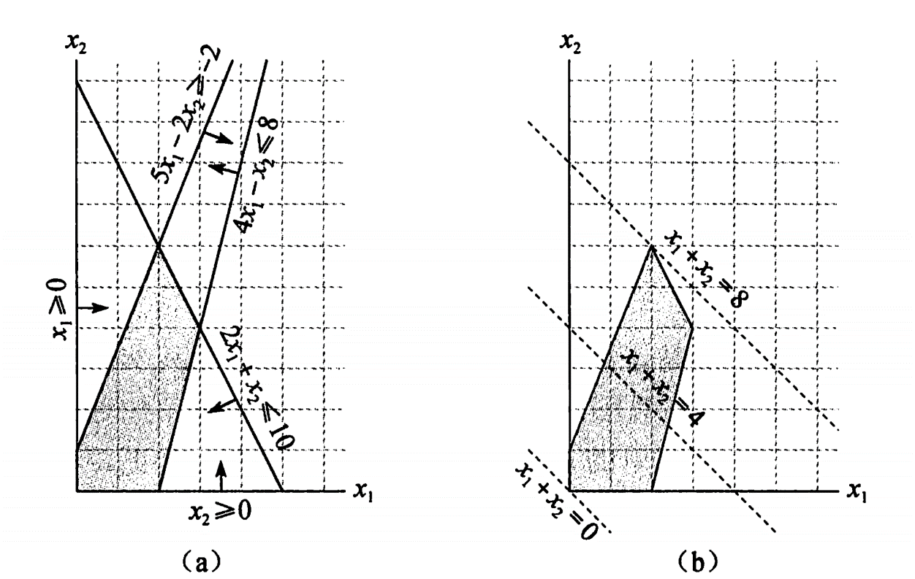




Considering one linear program with two variables
Maximize:
Subject to:
$$5x_{1}−2x_{2}≥−2$$

Slide 6
Although we cannot easily graph linear programs with more than two variables, the same intuition holds.
If we have three variables, then each constraint is described by a half-space in three dimensional space. The intersection of these half-space froms the feasible region.
If we have n variables, then each constraint is described by a half-space in n dimensional space. The intersection of these half-space froms the feasible region.

Slide 7
Standard Form
In standard form, we are given n real numbers ;
m real numbers ;
and mn real numbers for and ;
Finding n real numbers that
Maximize:
Subject to:
for
for

Slide 8



This linear program can be rewritten as,
Maximize：
Subject to：
where
$$A=\left(a_{ij}\right) b=\left(b_{i}\right) c=\left(c_{j}\right) x=(x_{j})$$
A tuple (A, b, c) can represent a linear program in standard form.

Slide 9
Converting linear programs into standard form
For example, if we have the linear program ;
Minimize:
Subject to:

Slide 10
By negating the coefficients of the objective function,
we get
Maximize:
Subject to:

Slide 11
To ensure that each variable has a non-negativity constraint,
we have
Maximize:
Subject to:

Slide 12
For consistency in variable names,
we have
Maximize:
Subject to:

Slide 13
Converting linear programs into slack form;
We introduce slack variables x₄ ,x₅ ,x₆, the linear programs we just
discuessed can be written as
Minimize:
Subject to:

Slide 14



As in standard form, we use b_{i}, c_{j} and a_{ij} to denote constant terms and coefficients. Thus we can concisely define a slack form by a tuple (N, B, A, b, c, v) to denote the slack form
for
Here, the equations is indexed by B and the variables on the right-hand is indexed by N.

Slide 15






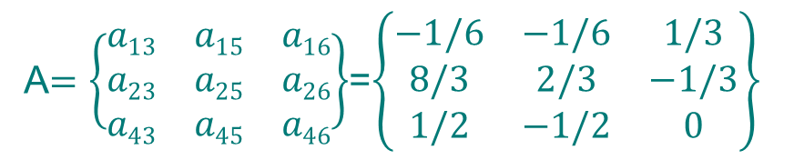

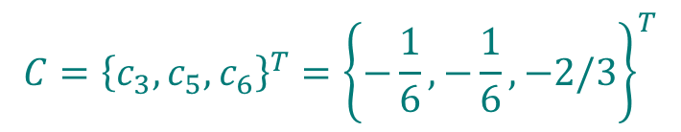
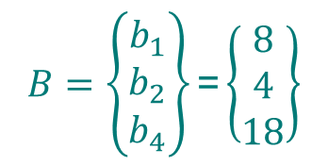
For example, in the slack form
We have
$$B=\left\{\begin{aligned}b_{1} \\ b_{2} \\ b_{4}\end{aligned}\right\}\text{=}\left\{\begin{aligned}8 \\ 4 \\ 18\end{aligned}\right\}$$
$$C={\left\{c_{3},c_{5},c_{6}\right\}}^{T}={\left\{−\frac{1}{6},−\frac{1}{6},−2/3\right\}}^{T}$$

Slide 16





The simplex algorithm
Consider the following linear program in standard form:
Maximize:
Subject to:

Slide 17




In order to use the simplex algorithm, we must convert the linear program into slack form
Maximize:
Subject to:
This system has 3 equations and 6 variables, and therefore has an infinite number of solutions.
Basic solution:
If a basic solution is also feasible, we call it a basic feasible solution.

Slide 18






Since the third constraint is the tightest constraint, we switch x₁ and x₆.
The linear program is rewritten as
The operation is call pivot.
New basic solution:
New objective function:

Slide 19
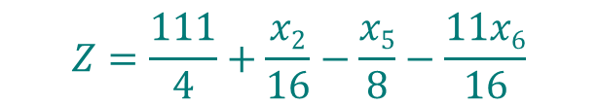



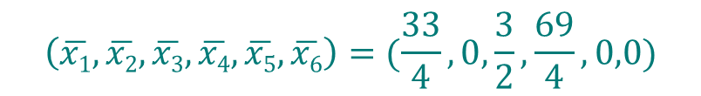

Since the third constraint is the tightest constraint again, we switch x₃ and x₅.
The linear program is rewritten as
New basic solution:
New objective function:

Slide 20





Now the only way to increase the objective value is to increase x₂.
The linear program is rewritten as
All coefficients in the objective function are negative, as means the basic solution is the optimal solution.
Basic solution(also optimal solution):
Objective function(also final solution) :

Slide 21
Exercise1
A company plans to manufacture two products. It is known that the time of equipment A and equipment B respectively occupied by manufacturing one ton, the time of the debugging process and the time available for these two products each day, and the profit when selling one ton each are shown in the following table. Ask the company how many tons each of the two products should be manufactured to maximize the profit. Solve with simplex algorithm.
Project | Product 1 | Product 2 | Available Time
Equipment A /h | 0 | 5 | 15
Equipment B /h | 6 | 2 | 24
Debugging process/h | 1 | 1 | 5
Profit /10000 yuan | 2 | 1

Slide 22
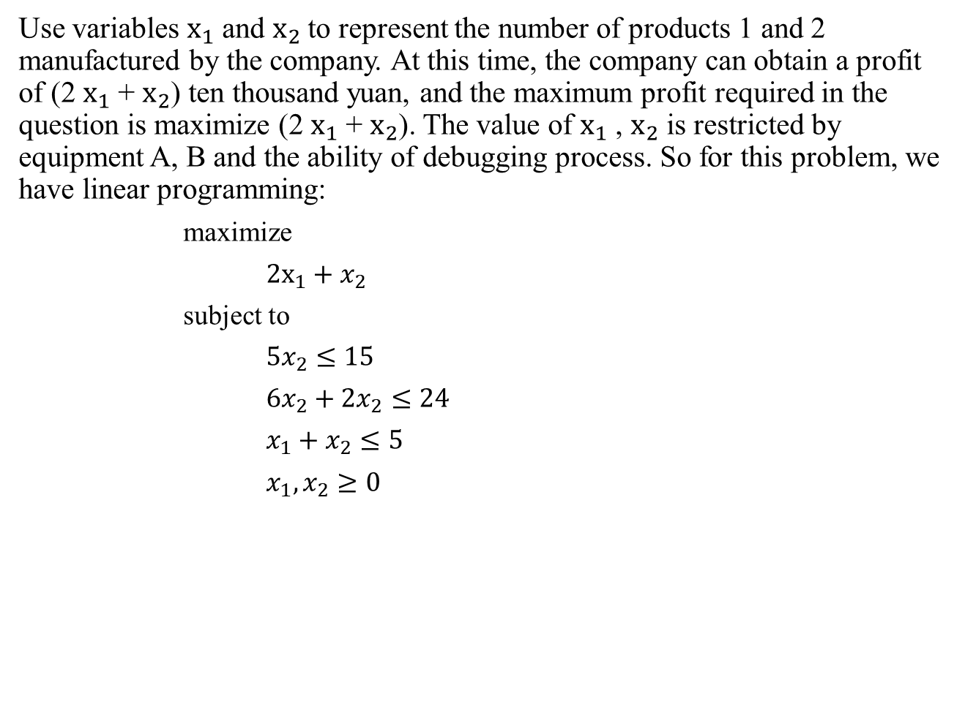
Use variables $x_{1}$ and $x_{2}$to represent the number of products 1 and 2 manufactured by the company. At this time, the company can obtain a profit of (2 $x_{1}$ + $x_{2}$) ten thousand yuan, and the maximum profit required in the question is maximize (2 $x_{1}$ + $x_{2}$). The value of $x_{1}$ , $x_{2}$ is restricted by equipment A, B and the ability of debugging process. So for this problem, we have linear programming:
maximize
$2x_{1}+x_{2}$
subject to
$5x_{2}≤15$
$6x_{2}+2x_{2}≤24$
$x_{1}+x_{2}≤5$
$x_{1}, x_{2}≥0$

Slide 23

Slack form：
maximize
$z=2x_{1}+x_{2}$
subject to
$x_{3}=15−5x_{2}$
$x_{4}=24−6x_{1}−2x_{2}$
$x_{5}=5−x_{1}− x_{2}$
Basic solution： ($\overline{x_{1}},\overline{x_{2}},\overline{x_{3}},\overline{x_{4}},\overline{x_{5}})=(0, 0, 15, 24, 5)$

Slide 24

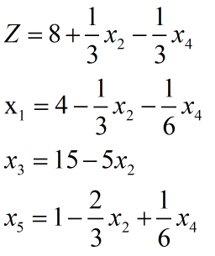

Switch $x_{1}$a$nd x_{4}$：
The linear program ：
New basic solution: ($\overline{x_{1}},\overline{x_{2}},\overline{x_{3}},\overline{x_{4}},\overline{x_{5}})=$(4, 0, 15, 0, 1)
Z=8

Slide 25

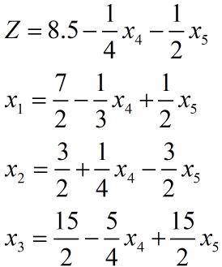

Switch $x_{2}$a$nd x_{5}$：
The linear program ：
New basic solution: ($\overline{x_{1}},\overline{x_{2}},\overline{x_{3}},\overline{x_{4}},\overline{x_{5}})=$($\frac{7}{2}$, $\frac{3}{2}$, $\frac{15}{2}$, 0, 0)
Z=8.5

Slide 26
Exercise2
According to the contract, a company provides products to the sales company at the end of each quarter. The relevant information is as follows. If there are too many products in the current season and there is a surplus at the end of the season, a storage fee of 2,000 yuan will be paid for each ton of products in a quarter. Now the factory considers the best production plan, so that the factory has the lowest annual production cost when the contract is completed (and there is no surplus at the end of the year). Try to define three different forms of decision variables for this problem, so as to construct linear programming in different ways.
Quarter j | Production capacity (ton) | Production cost (ten thousand yuan/ton) | Demand (ton)
1 | 30 | 15.0 | 20
2 | 40 | 14.0 | 20
3 | 20 | 15.3 | 30
4 | 10 | 14.8 | 10

Slide 27
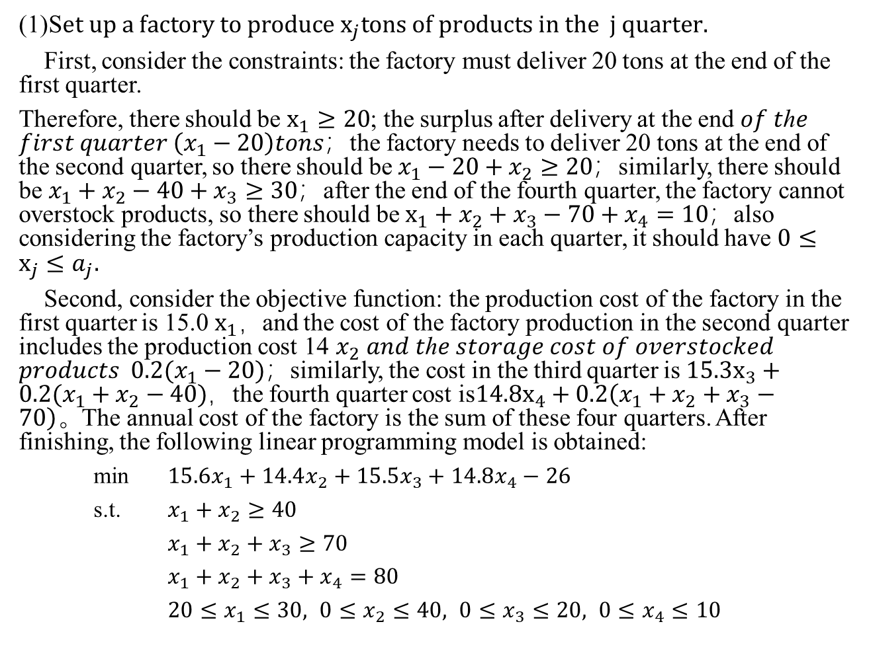
(1)S$et up a factory to produce x_{j}tons of products in the j quarter.$
First, consider the constraints: the factory must deliver 20 tons at the end of the first quarter.
Therefore, there should be $x_{1}≥20$; the surplus after delivery at the end 𝑜𝑓 𝑡ℎ𝑒 𝑓𝑖𝑟𝑠𝑡 𝑞𝑢𝑎𝑟𝑡𝑒𝑟 $\left(x_{1}−20\right)tons$；the factory needs to deliver 20 tons at the end of the second quarter, so there should be $x_{1}−20+x_{2}≥20；$similarly, there should be $x_{1}+x_{2}−40+x_{3}≥30；$after the end of the fourth quarter, the factory cannot overstock products, so there should be $x_{1}+x_{2}+x_{3}−70+x_{4}=10；$also considering the factory’s production capacity in each quarter, it should have $0≤x_{j}≤a_{j}.$
Second, consider the objective function: the production cost of the factory in the first quarter is 15.0$x_{1}，$and the cost of the factory production in the second quarter includes the production cost 14 $x_{2}$ 𝑎𝑛𝑑 𝑡ℎ𝑒 𝑠𝑡𝑜𝑟𝑎𝑔𝑒 𝑐𝑜𝑠𝑡 𝑜𝑓 𝑜𝑣𝑒𝑟𝑠𝑡𝑜𝑐𝑘𝑒𝑑 𝑝𝑟𝑜𝑑𝑢𝑐𝑡𝑠 $0.2(x_{1}−20)；$similarly, the cost in the third quarter is $15.3x_{3}+0.2(x_{1}+x_{2}−40)$，the fourth quarter cost is$14.8x_{4}+0.2\left(x_{1}+x_{2}+x_{3}−70\right)。$The annual cost of the factory is the sum of these four quarters. After finishing, the following linear programming model is obtained:
min $15.6x_{1}+14.4x_{2}+15.5x_{3}+14.8x_{4}−26$
s.t. $x_{1}+x_{2}≥40$
$x_{1}+x_{2}+x_{3}≥70$
$x_{1}+x_{2}+x_{3}+x_{4}=80$
$20≤x_{1}≤30, 0≤x_{2}≤40, 0≤x_{3}≤20, 0≤x_{4}≤10$

Slide 28
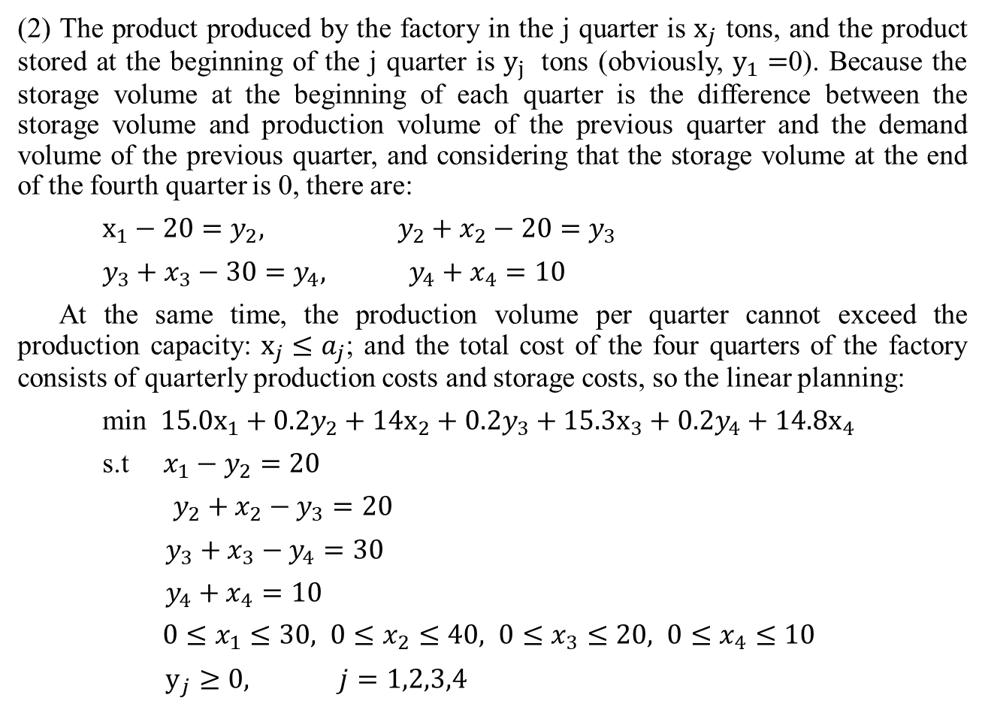
(2) The product produced by the factory in the j quarter is $x_{j}$ tons, and the product stored at the beginning of the j quarter is $y_{j}$ tons (obviously, $y_{1}=$0). Because the storage volume at the beginning of each quarter is the difference between the storage volume and production volume of the previous quarter and the demand volume of the previous quarter, and considering that the storage volume at the end of the fourth quarter is 0, there are:
$x_{1}−20=y_{2}, y_{2}+x_{2}−20=y_{3}$
$y_{3}+x_{3}−30=y_{4}, y_{4}+x_{4}=10$
At the same time, the production volume per quarter cannot exceed the production capacity: $x_{j}≤a_{j}$; and the total cost of the four quarters of the factory consists of quarterly production costs and storage costs, so the linear planning:
min ${15.0x}_{1}+0.2y_{2}+14x_{2}+0.2y_{3}+15.3x_{3}+0.2y_{4}+14.8x_{4}$
s.t $x_{1}−y_{2}=20$
$y_{2}+x_{2}−y_{3}=20$
$y_{3}+x_{3}−y_{4}=30$
$y_{4}+x_{4}=10$
$0≤x_{1}≤30, 0≤x_{2}≤40, 0≤x_{3}≤20, 0≤x_{4}≤10$
$y_{j}≥0, j=1,2,3,4$

Slide 29
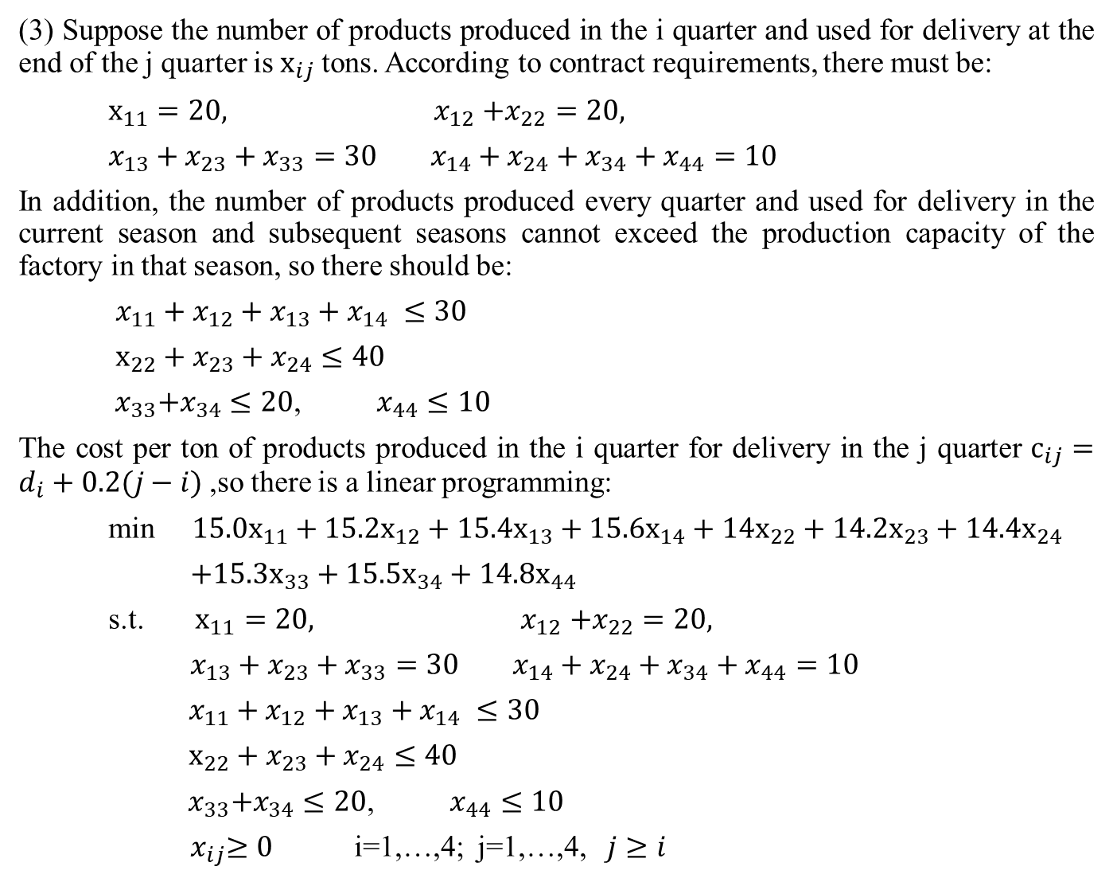
(3) Suppose the number of products produced in the i quarter and used for delivery at the end of the j quarter is $x_{ij}$tons. According to contract requirements, there must be:
$x_{11}=20, { x}_{12}+x_{22}=20,$
$x_{13}+x_{23}+x_{33}=30 x_{14}+x_{24}+x_{34}+x_{44}=10$
In addition, the number of products produced every quarter and used for delivery in the current season and subsequent seasons cannot exceed the production capacity of the factory in that season, so there should be:
$x_{11}+x_{12}+x_{13}+x_{14} ≤30$
$x_{22}+x_{23}+x_{24}≤40$
${ x}_{33}+x_{34}≤20$, $x_{44}≤10$
The cost per ton of products produced in the i quarter for delivery in the j quarter $c_{ij}=d_{i}+0.2(j−i)$,so there is a linear programming:
min $15.0x_{11}+15.2x_{12}+15.4x_{13}+15.6x_{14}+14x_{22}+14.2x_{23}+14.4x_{24}$
$+15.3x_{33}+15.5x_{34}+14.8x_{44}$
s.t. $x_{11}=20, { x}_{12}+x_{22}=20,$
$x_{13}+x_{23}+x_{33}=30 x_{14}+x_{24}+x_{34}+x_{44}=10$
$x_{11}+x_{12}+x_{13}+x_{14} ≤30$
$x_{22}+x_{23}+x_{24}≤40$
${ x}_{33}+x_{34}≤20$, $x_{44}≤10$
${ x}_{ij}≥0$ i=1,…,4; j=1,…,4, $j≥i$

